Slide 1


Threat Hunting 101
Presented by Aditya Bhandari

Slide 2

What we’ll cover today:
  What is Threat Hunting?
  SOC vs Threat Hunting
  Threat Hunting mindset

Slide 3

If no alerts are getting triggered are we safe?

Slide 4
Introduction to Threat Hunting
Threat hunting is a proactive approach focusing on identifying and mitigating hidden threats before they turn into significant breaches.

Slide 5
Why Threat Hunting Matters
Traditional Security:
  Alert-driven
  Reactive
  Misses stealthy attacks
Threat Hunting:
  Proactive
  Hypothesis-driven
  Finds attackers hiding in plain sight
VS
5

Slide 6
Why Threat Hunting Matters
Proactive Defense and Threat Detection
Proactive vs Reactive
Detect Hidden Threats
Reduce Dwell Time
Proactive threat hunting enables organizations to identify potential threats before they cause damage, contrasting with reactive approaches that respond only after an incident occurs, enhancing overall security.
By focusing on detection of hidden threats, threat hunters can uncover malicious activities that traditional security measures may overlook, effectively strengthening the organization's defenses against sophisticated attacks.
Reducing dwell time is crucial; quicker detection and response to threats minimize the opportunity for attackers to exploit vulnerabilities, ensuring a more resilient security posture for the organization.
6

Slide 7
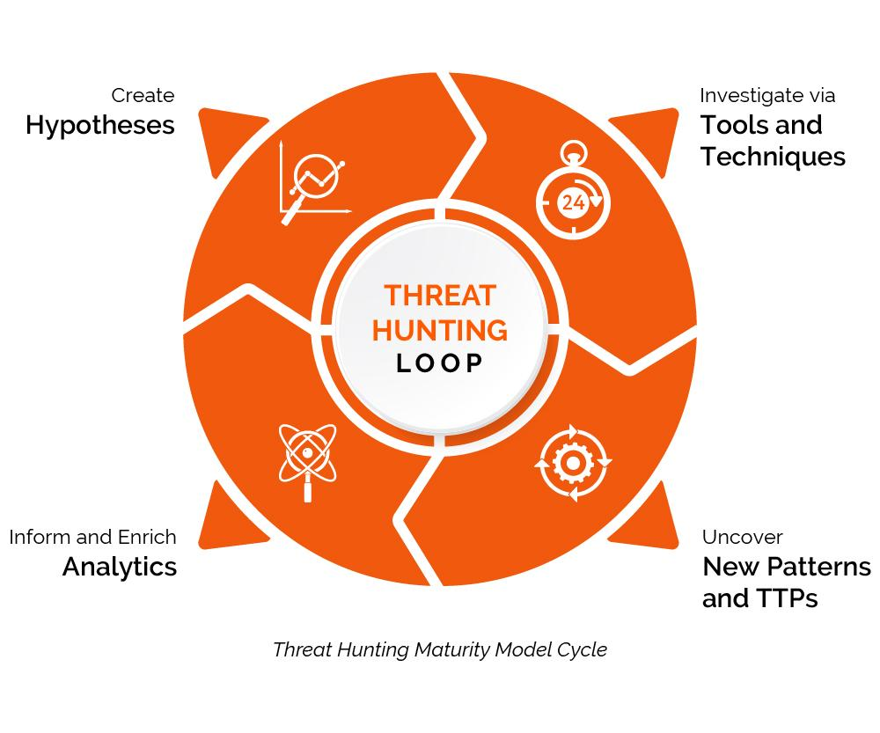
Understanding the Threat Hunting Lifecycle
The threat hunting lifecycle consists of structured phases that include
  hypothesis generation,
  investigation,
  response, and
  feedback,
enabling security teams to effectively identify and mitigate potential threats.

Slide 8

Phases of Threat Hunting
A Comprehensive Approach to Hunting
Preparation
Hypothesis Generation
Investigation
The preparation phase involves defining objectives, gathering necessary tools, and assembling a skilled team to set a solid foundation for effective threat hunting operations.
In this phase, analysts create educated guesses based on threat intelligence and environment data, which guide the hunting process towards likely areas of compromise or vulnerability.
During investigation, analysts actively search for indicators of compromise, utilizing various data sources to uncover hidden threats and validate or refute the generated hypotheses.
8

Slide 9
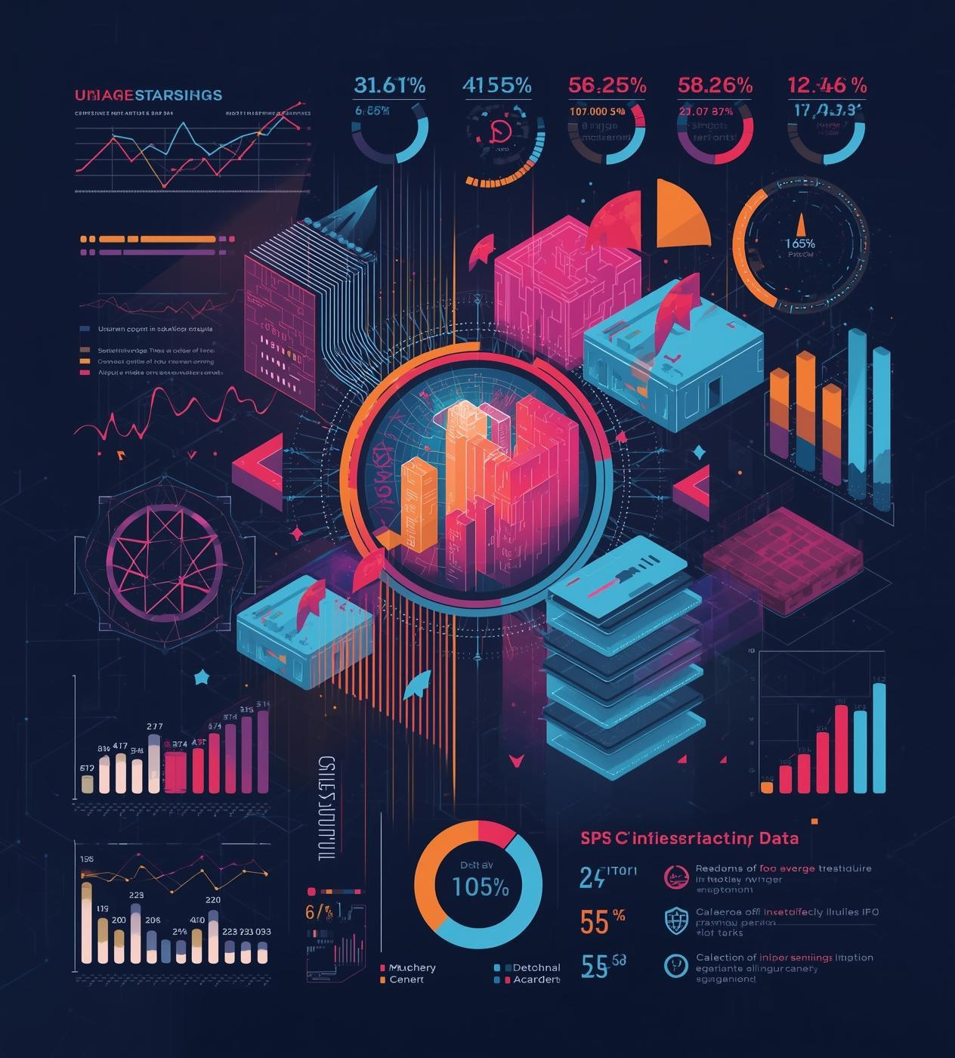
Core Concepts of Threat Hunting
Understanding the fundamentals of threat hunting is essential. It involves recognizing various cyber threats, utilizing key terminology, and analyzing data sources to effectively protect and secure organizational assets.

Slide 10
Types of Threats
Understanding Common Cybersecurity Challenges
Malware
Insider Threats
Advanced Persistent Threats (APTs)
Malware is malicious software designed to disrupt, damage, or gain unauthorized access to computer systems. It encompasses various types, including viruses, worms, and ransomware, posing severe risks to organizations.
Insider threats arise from individuals within an organization who misuse their access to steal data or compromise security. These threats can be intentional or unintentional, making them particularly challenging to detect.
APTs are prolonged and targeted cyberattacks where an intruder gains access to a network and remains undetected for an extended period. These threats aim to steal sensitive information or disrupt operations.
10

Slide 11
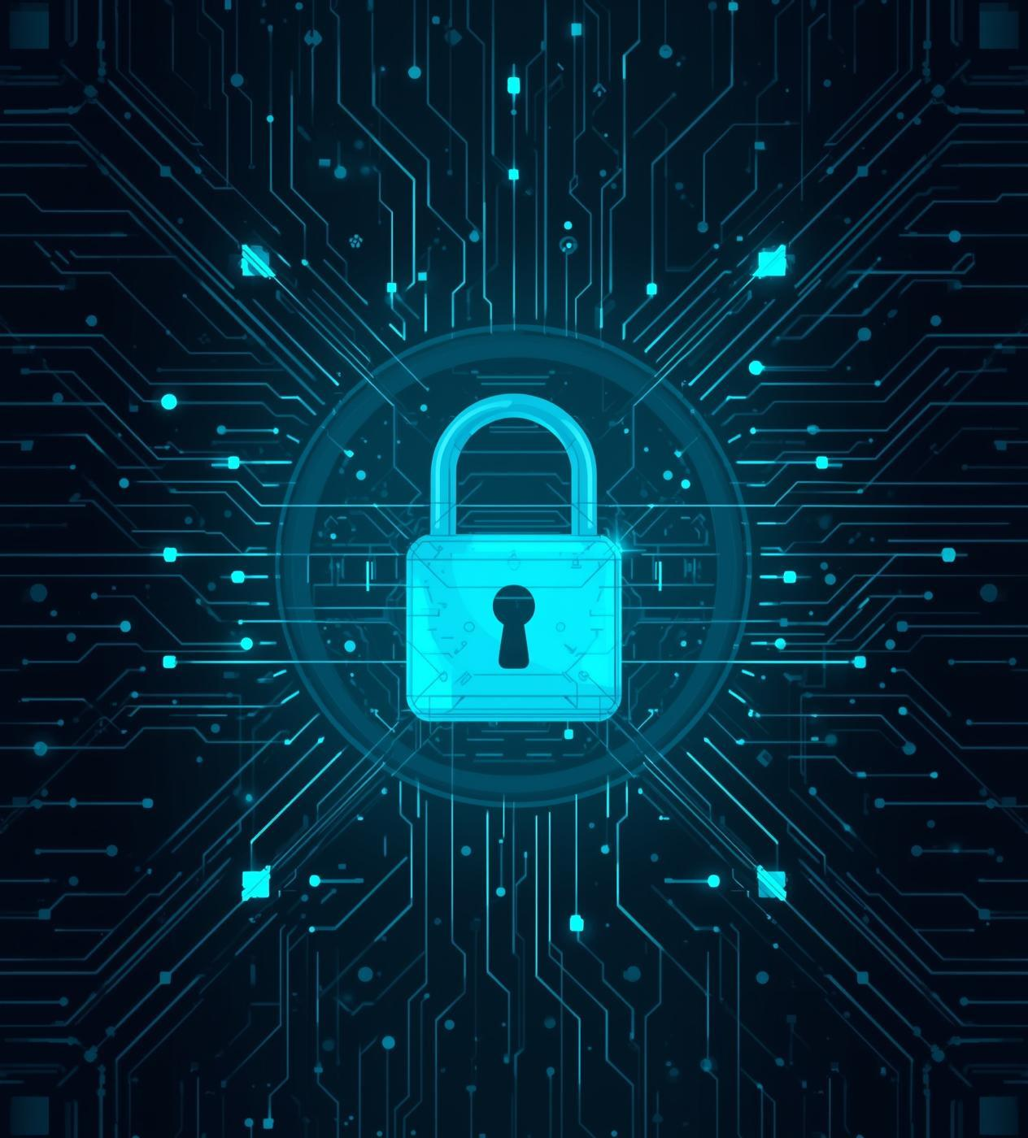
Key Terms in Threat Hunting
Understanding Indicators of Compromise (IoCs) and Tactics, Techniques, and Procedures (TTPs) is essential for effective threat hunting, enabling cybersecurity professionals to identify and mitigate potential threats proactively.

Slide 12

Essential Data Sources for Threat Hunting
Effective threat hunting relies on diverse data sources such as logs, network traffic, and endpoint data. These sources provide critical insights, enabling analysts to identify and respond to potential threats swiftly.

Slide 13
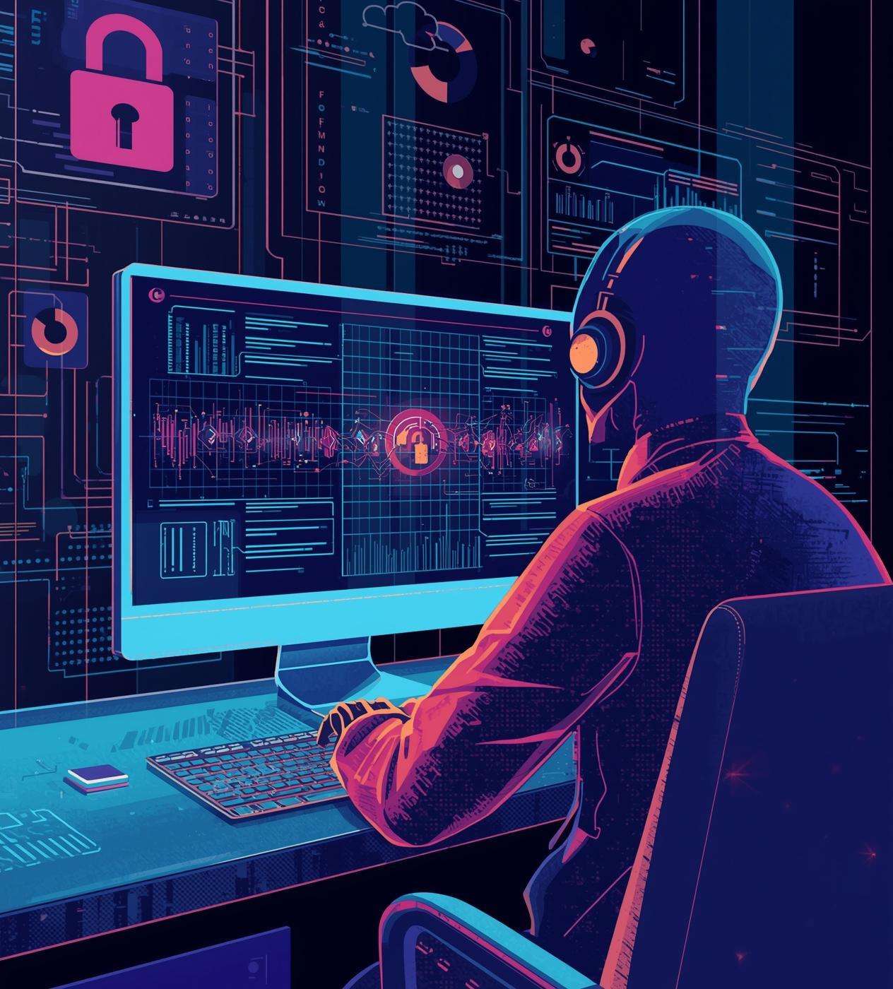
Techniques for Effective Threat Hunting
Utilizing pattern recognition and anomaly detection enhances detection capabilities, while integrating threat intelligence ensures hunters stay alert to evolving tactics, thus strengthening proactive defense measures against cyber threats.

Slide 14
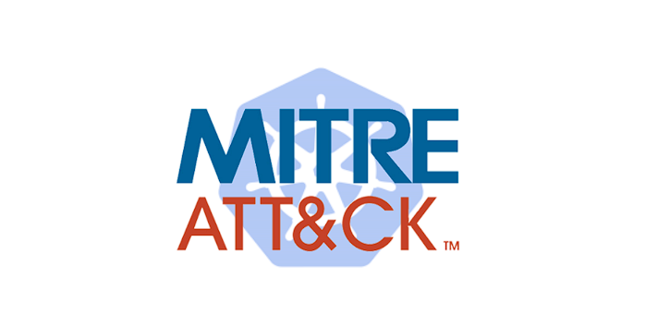
Using MITRE ATT&CK Framework Effectively
The MITRE ATT&CK framework offers a structured approach to threat hunting, providing security teams with a comprehensive matrix of tactics and techniques that enhance detection and response capabilities against potential cyber threats.

Slide 15
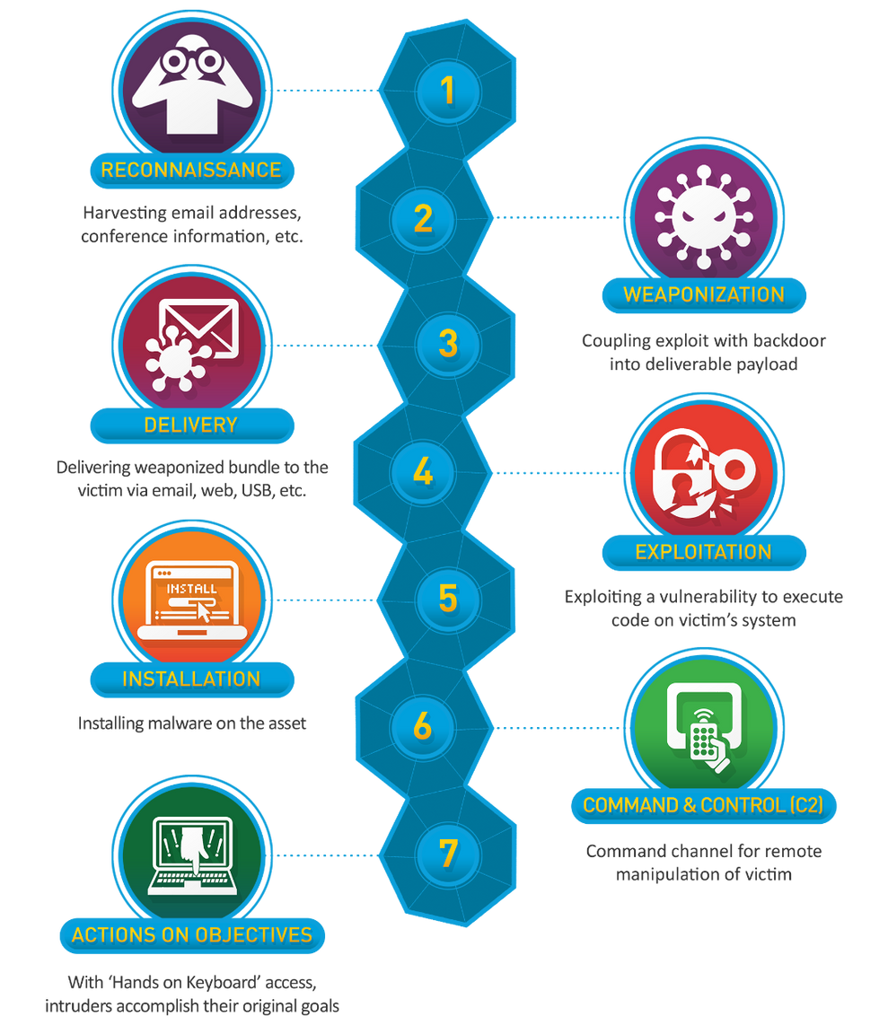
Cyber Kill Chain
The Cyber Kill Chain, developed by Lockheed Martin, is a cybersecurity framework that breaks down cyberattacks into sequential stages, helping defenders detect and disrupt threats from initial reconnaissance to achieving objectives like data theft or system disruption, offering a clear way to build defenses at each phase. The core seven stages are: Reconnaissance, Weaponization, Delivery, Exploitation, Installation, Command & Control (C2), and Actions on Objectives.

Slide 16
SIEM Systems Overview
Understanding their role in threat hunting
Centralized Logging
Real-Time Monitoring
Incident Response
SIEM systems consolidate logs from various sources, enabling comprehensive visibility into security events, which is crucial for detecting and investigating potential threats effectively.
These systems offer real-time monitoring of security events, allowing SOC teams to respond promptly to emerging threats and reduce the risk of significant breaches.
SIEM platforms facilitate a structured incident response process, helping teams to analyze, prioritize, and effectively remediate security incidents based on correlated data insights.
16

Slide 17
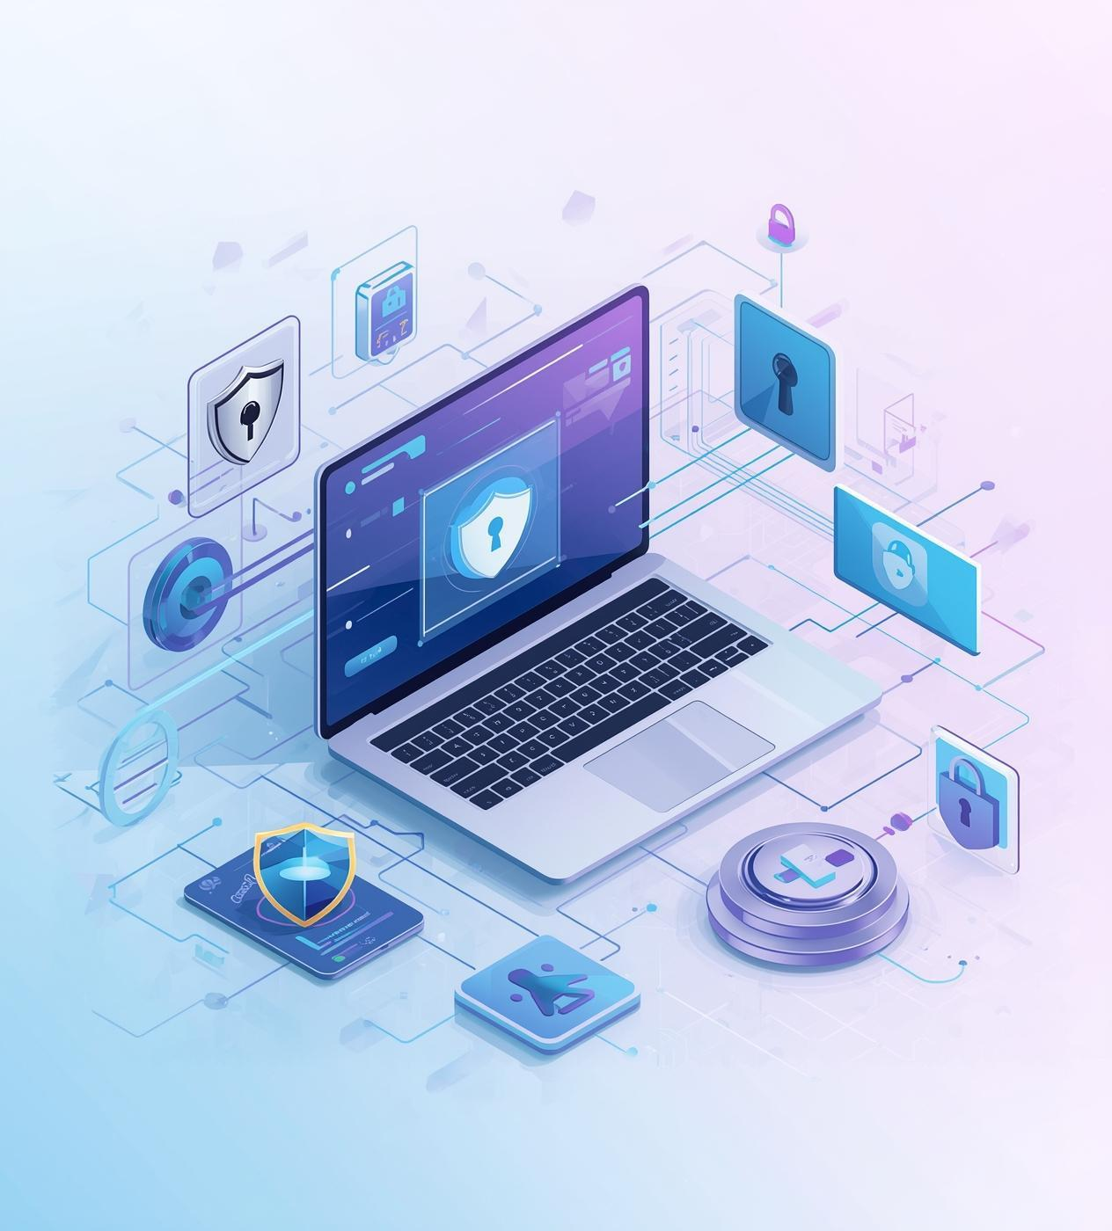
Capabilities of EDR Tools
Endpoint Detection and Response (EDR) tools provide real-time monitoring, automated threat detection, and incident response capabilities, allowing organizations to swiftly address potential breaches and enhance overall endpoint security effectively.

Slide 18

Analyzing Network Traffic Effectively
Network traffic analysis tools play a crucial role in threat hunting. They help detect anomalies, monitor data flow, and investigate potential security incidents, ensuring robust cybersecurity across the network infrastructure.

Slide 19

Questions?
Start your journey in threat hunting!

